Slide 1
Programming SAP-1 part 2

Slide 2
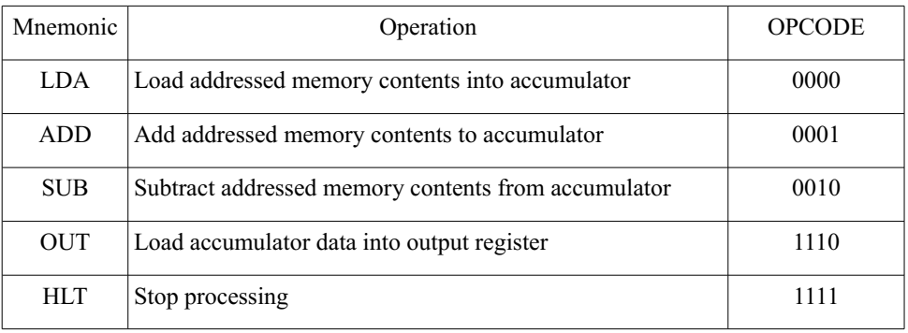
The instruction format of SAP-1 Computer is
(XXXX) (XXXX)
the first four bits make the opcode while the last four bits make the operand(address).
SAP-1 instruction set consists of following instructions

Slide 3
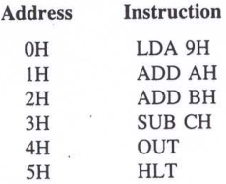
Exercise 1
Q: Translate the program into SAP1 machine language.
Program:

Slide 4
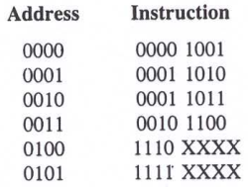
Answer:
Machine language:

Slide 5
Exercise 2
Q: Write down the program (assembly language and machine language) to get the result in SAP1 for the following arithmetical expression.
16 + 20 + 24 -32 (decimal)

Slide 6
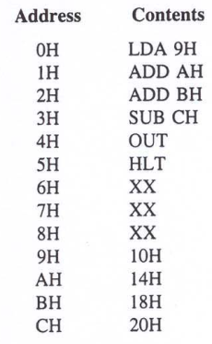
Answer:
Assembly language:

Slide 7
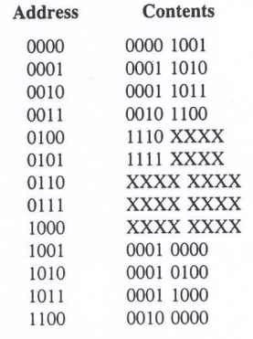
Answer:
Machine language:
The program is stored in the low-memory. And data is stored in the high-memory.

Slide 8
Machine cycle and Instruction cycle
SAP1 has six T-states (three fetch and three execute cycles) reserved for each instruction. Not all instructions require all the six T-states for execution. The unused T- state is marked as No Operation (NOP) cycle. Each T-state is called a machine cycle for SAP1. A ring counter is used to generate a T-state at every falling edge of clock pulse. The ring counter output is reset after the 6th T-state.
FETCH CYCLE – T1, T2, T3 machine cycle
EXECUTE CYCLE - T4, T5, T6 machine cycle

Slide 9
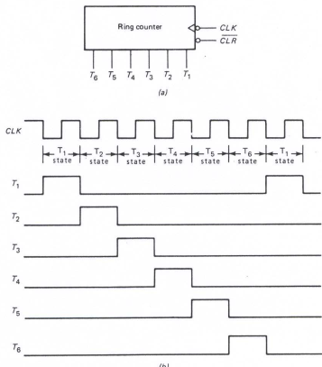
Ring counter
Figure: a. Ring counter symbol
b. Clock and timing signals

Slide 10
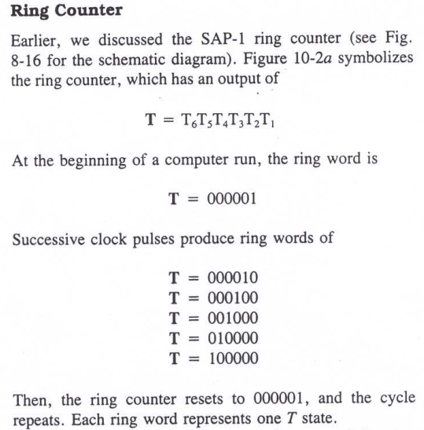
Ring counter
Notes:
1010

Slide 11
Machine cycle and Instruction cycle
SAP1 has six T-states (three fetch and three execute cycles) reserved for each instruction. Not all instructions require all the six T-states for execution. The unused T- state is marked as No Operation (NOP) cycle. Each T-state is called a machine cycle for SAP1. A ring counter is used to generate a T-state at every falling edge of clock pulse. The ring counter output is reset after the 6th T-state.

Slide 12
FETCH CYCLE
FETCH CYCLE – T1, T2, T3 machine cycle
T1 (Address state),
T2 (Increment state),
T3 (Memory state)

Slide 13
EXECUTE CYCLE
EXECUTE CYCLE - T4, T5, T6 machine cycle
The next three states (T4, T5, T6) are the execution cycle of SAP1. The register transfers during the execution cycle depend on the particular instruction being executed. For example, LDA 9H requiers different register transfer than ADD BH.

Slide 14
Instruction routine
LDA routine
ADD routine
SUB routine
OUT routine
HLT routine
T1, T2, T3 machine cycle
is same for all instruction

Slide 15
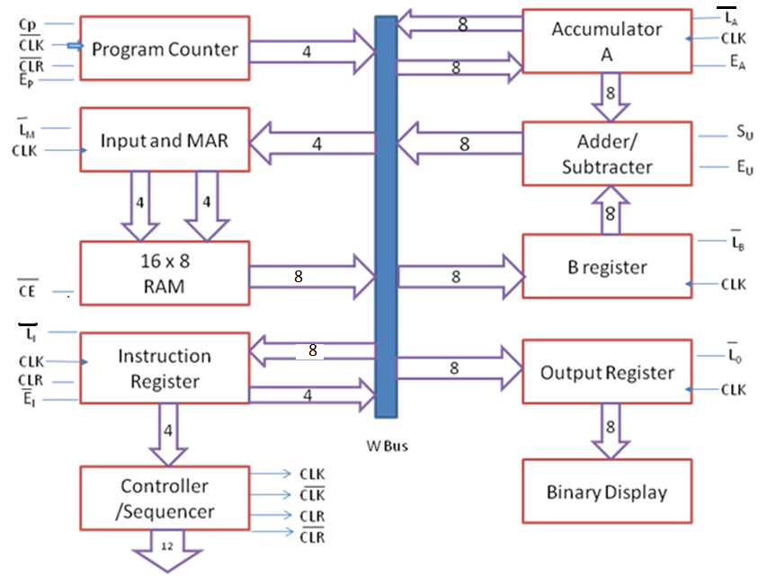
Block diagram of Simple-As-Possible (SAP)-1 Architecture
CON = C_{P} E_{P} L’_{M} CE’ L’_{I} E’_{I} L’_{A} E_{A} S_{U} E_{U} L’_{B} L’_{O}

Slide 16
FETCH CYCLE

Slide 17
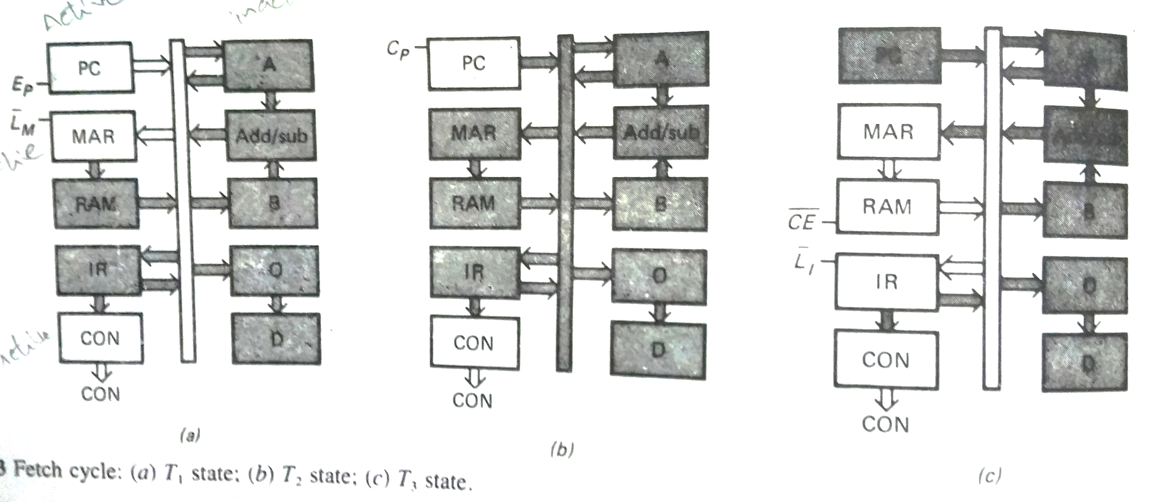
Fetch cycle : T1, T2, T3

Slide 18
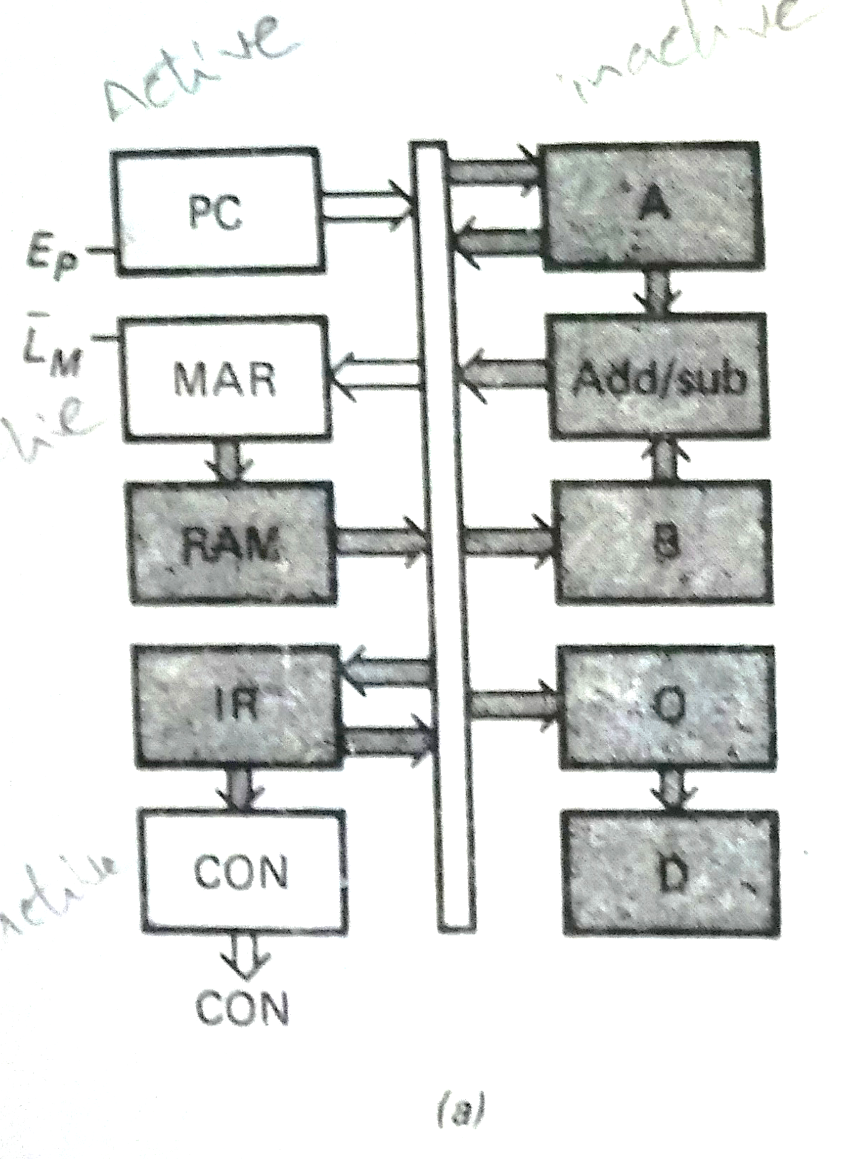
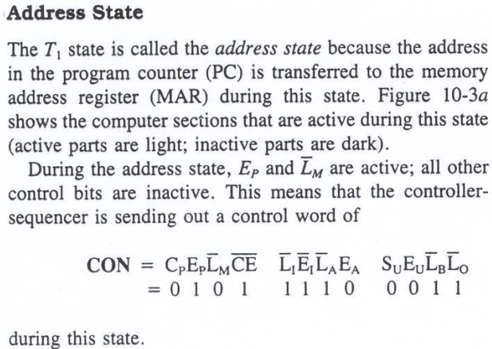
T1: Address state

Slide 19
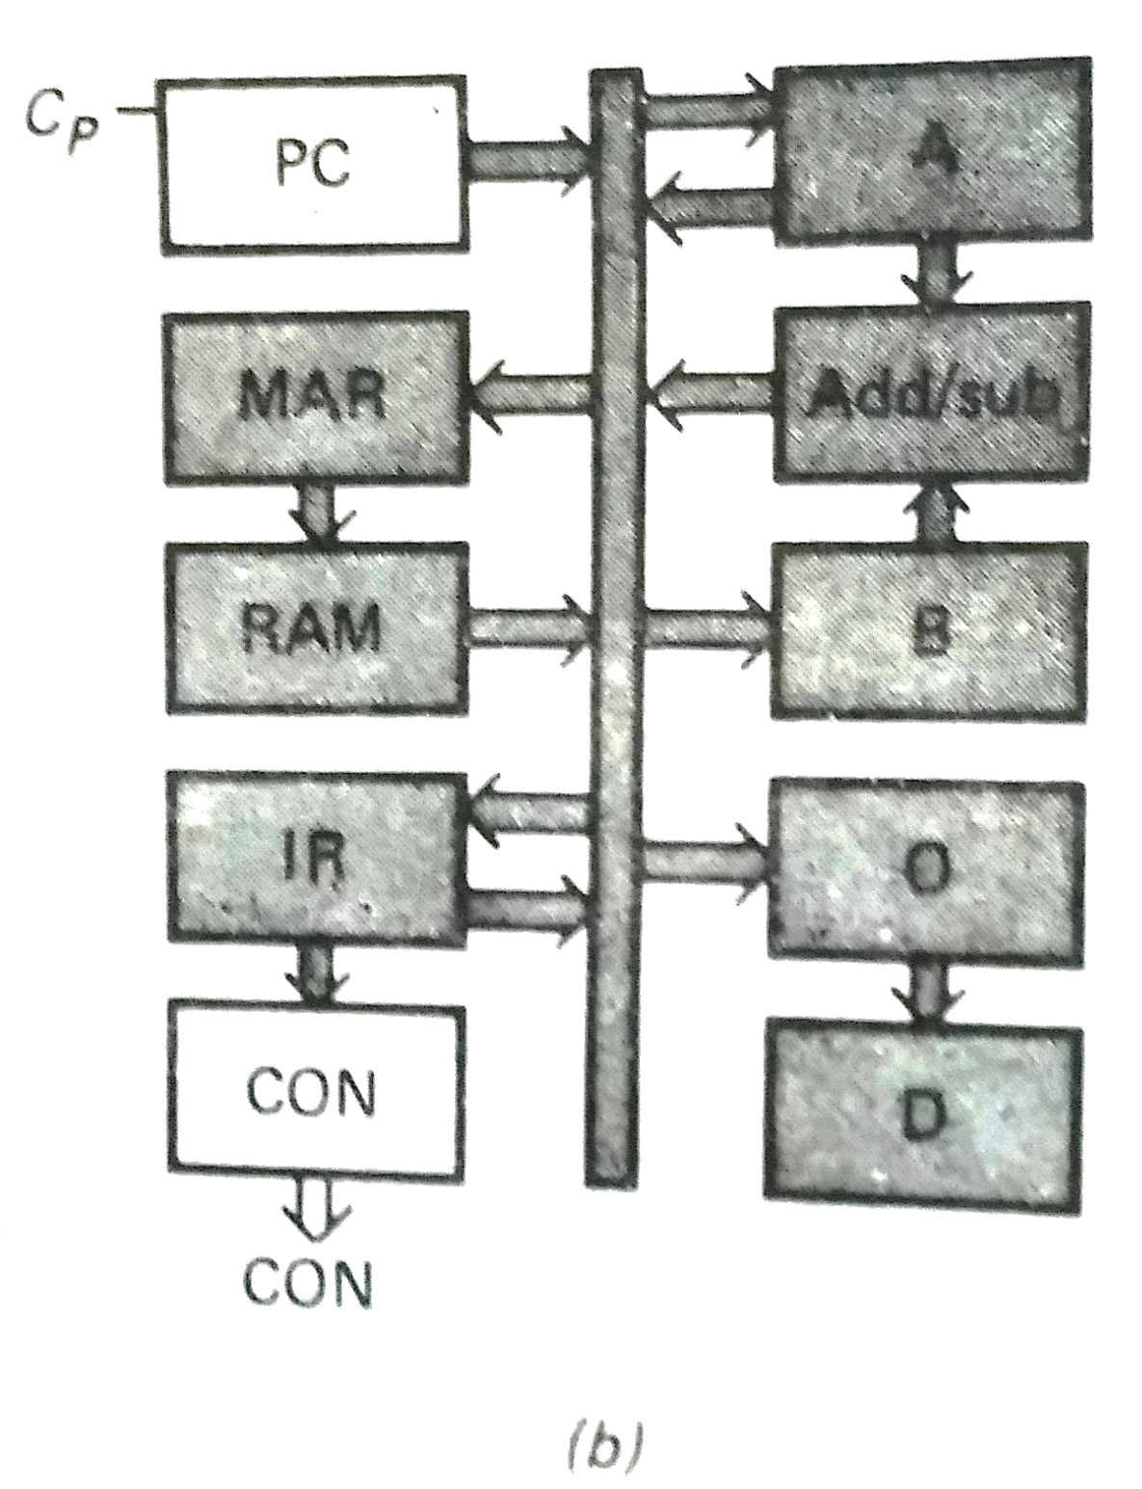
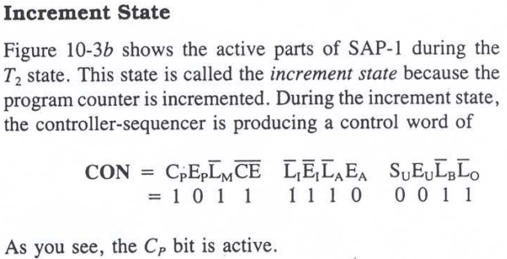
T2: Increment state

Slide 20
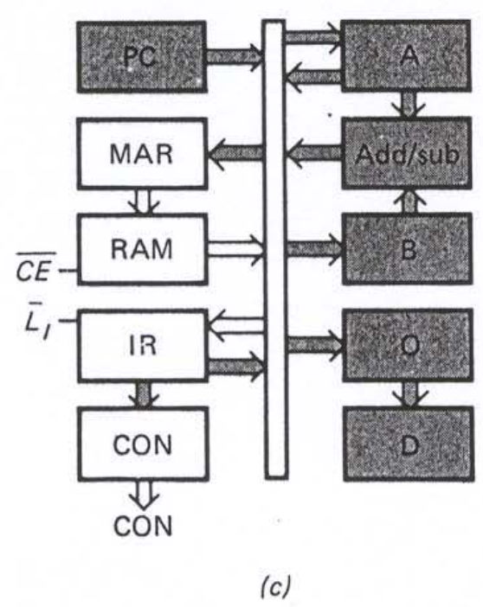
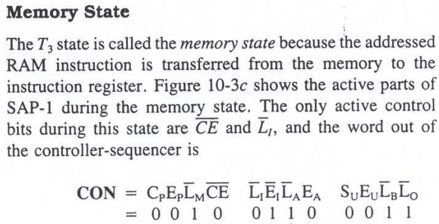
T3: memory state

Slide 21
EXECUTE CYCLE

Slide 22
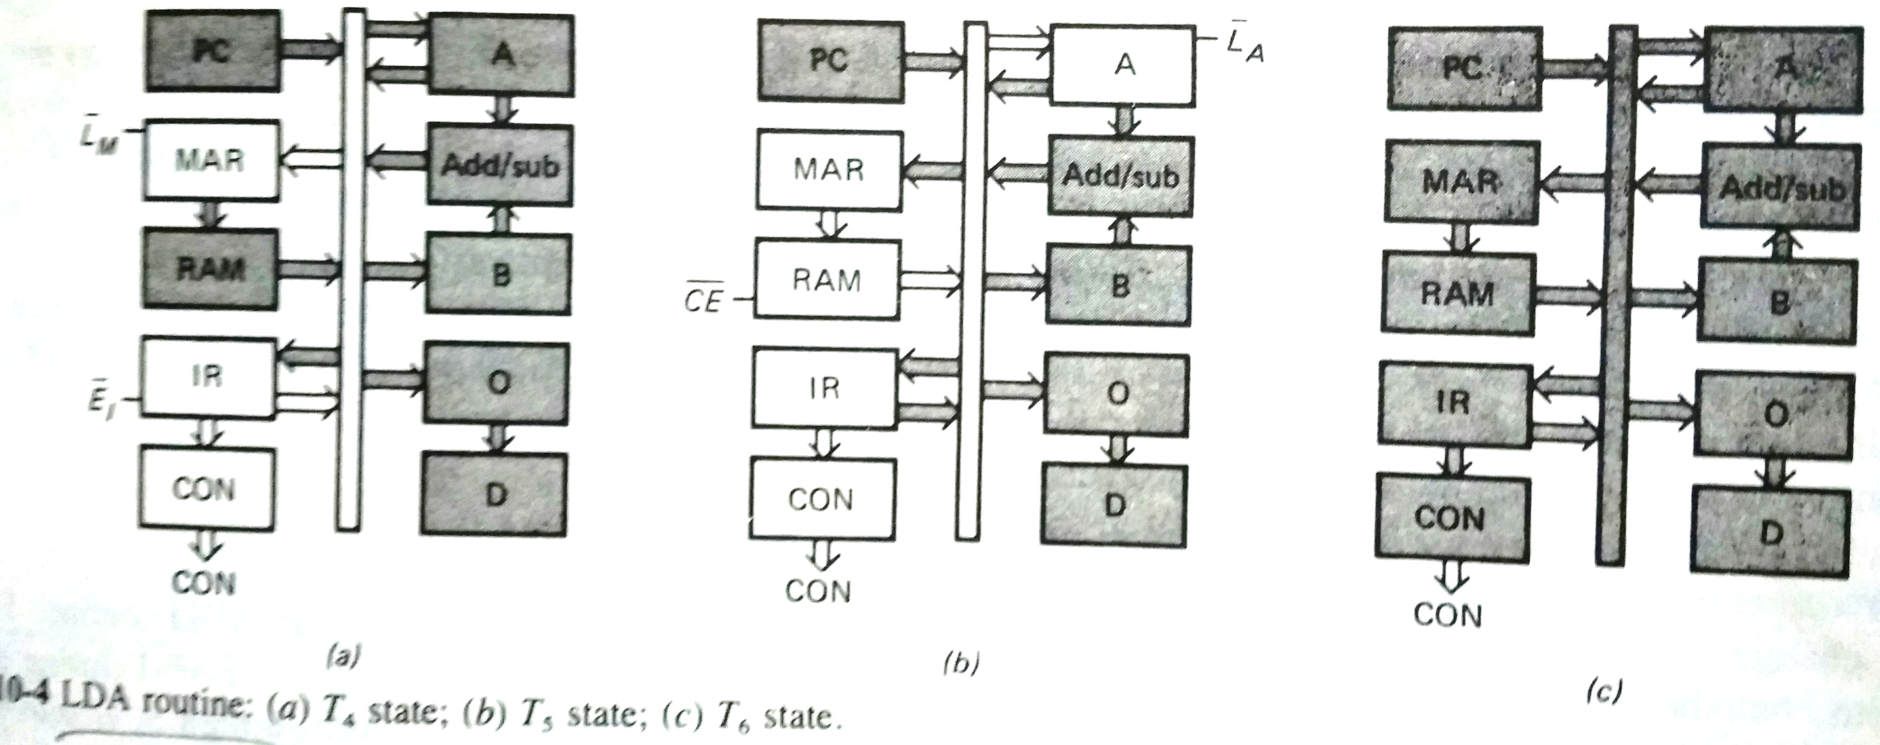
LDA routine (a) T4 state (b) T5 state (c) T6 state

Slide 23
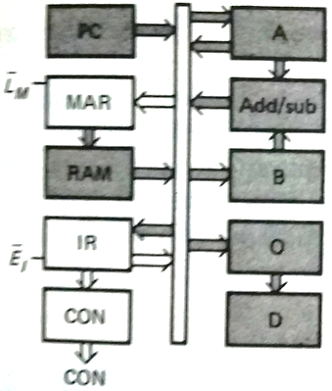
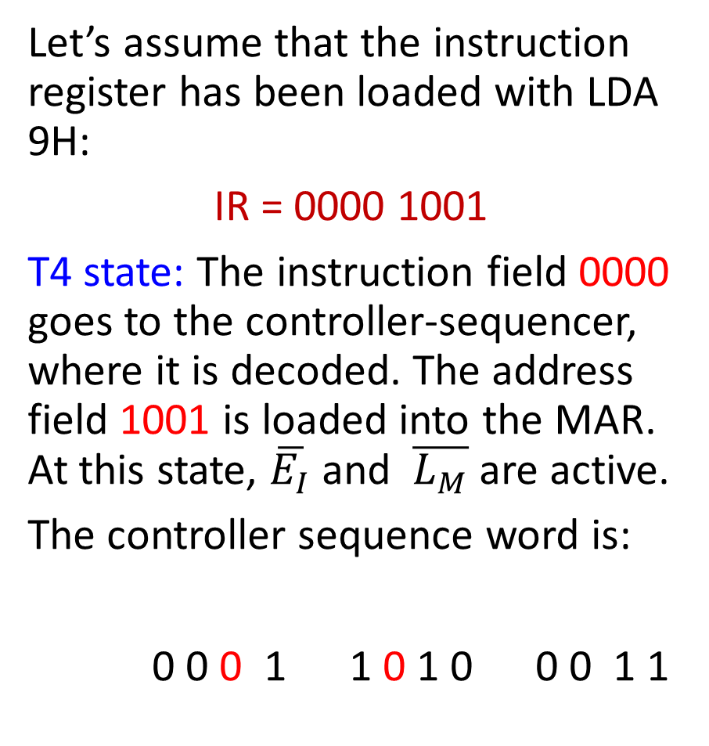
LDA routine (a) T4 state
Let’s assume that the instruction register has been loaded with LDA 9H:
IR = 0000 1001
T4 state: The instruction field 0000 goes to the controller-sequencer, where it is decoded. The address field 1001 is loaded into the MAR. At this state, $\overline{E_{I}}$ and $\overline{L_{M}}$ are active.
The controller sequence word is:
0 0 0 1 1 0 1 0 0 0 1 1

Slide 24
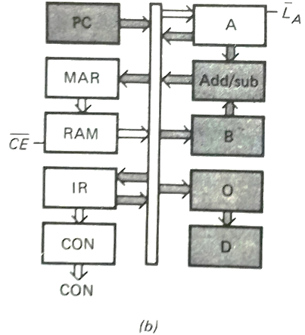
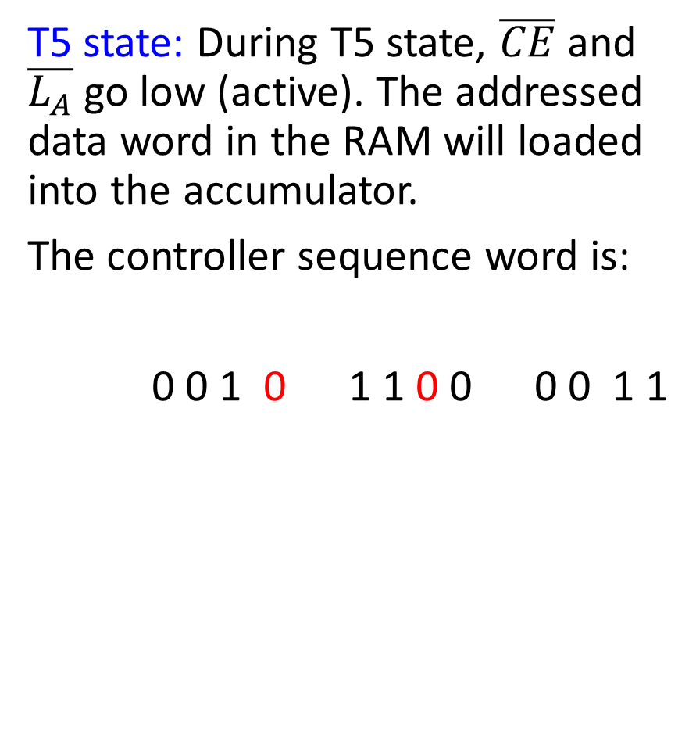
LDA routine (b) T5 state
T5 state: During T5 state, $\overline{CE}$ and $\overline{L_{A}}$ go low (active). The addressed data word in the RAM will loaded into the accumulator.
The controller sequence word is:
0 0 1 0 1 1 0 0 0 0 1 1

Slide 25
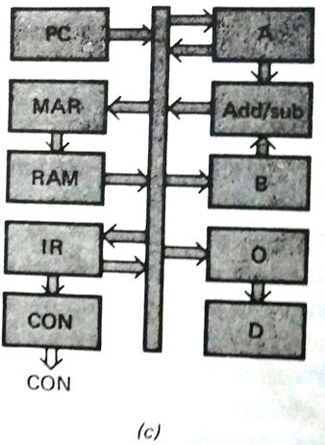
LDA routine (c) T6 state
T6 state: T6 state is non-operational for LDA routine, all registers all inactive. This means that the controller-sequencer is sending out a word whose bits all inactive. The T6 state of LDA routine is inactive.
The controller sequence word is:
0 0 1 1 1 1 1 0 0 0 1 1

Slide 26
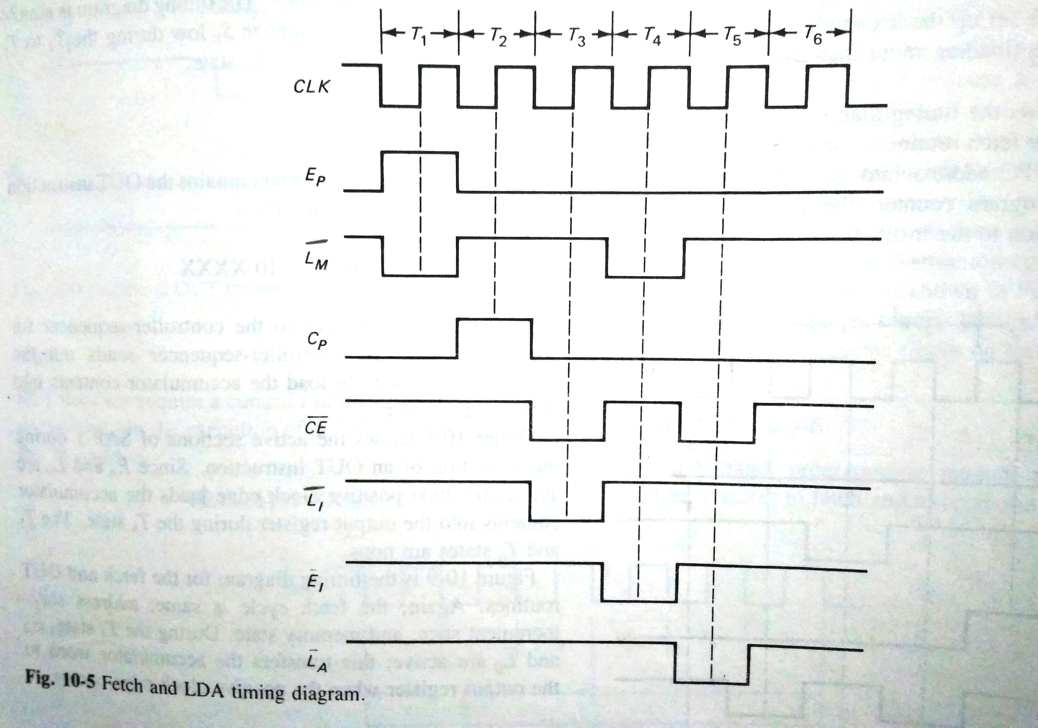
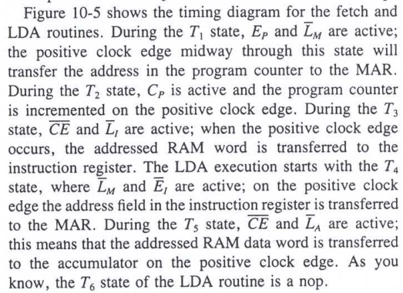
Timing diagram showing LDA routine (Fetch cycle and Execute cycle)

Slide 27
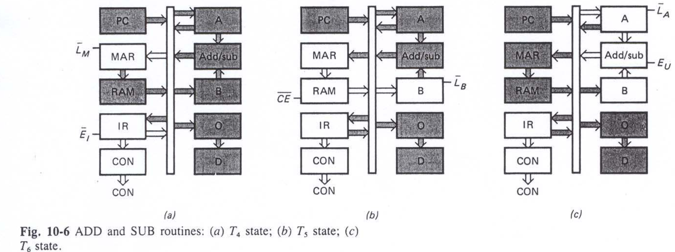
ADD routine (a) T4 state (b) T5 state (c) T6 state

Slide 28
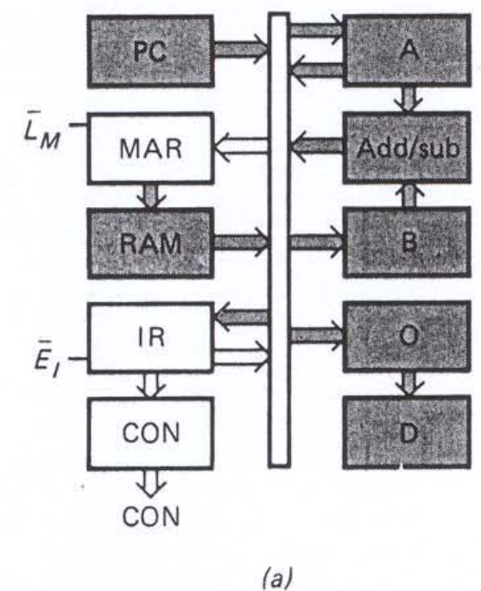
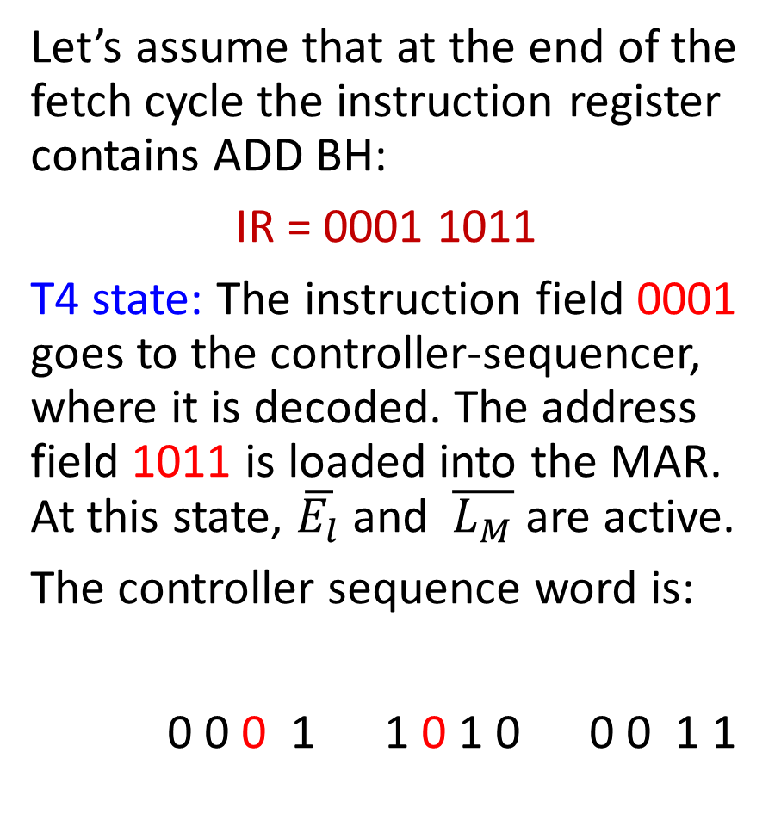
ADD routine (a) T4 state
Let’s assume that at the end of the fetch cycle the instruction register contains ADD BH:
IR = 0001 1011
T4 state: The instruction field 0001 goes to the controller-sequencer, where it is decoded. The address field 1011 is loaded into the MAR. At this state, $\overline{E_{l}}$ and $\overline{L_{M}}$ are active.
The controller sequence word is:
0 0 0 1 1 0 1 0 0 0 1 1

Slide 29
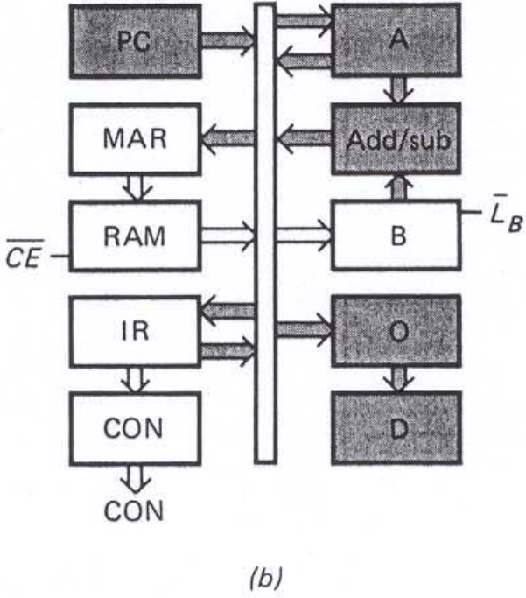
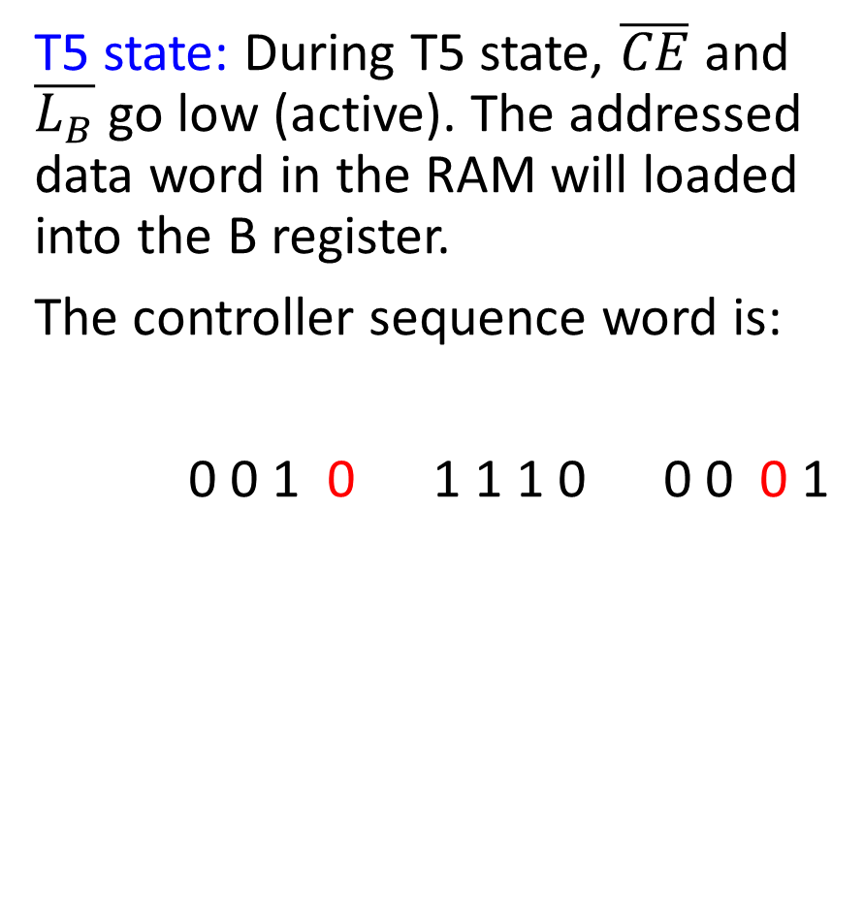
ADD routine (b) T5 state
T5 state: During T5 state, $\overline{CE}$ and $\overline{L_{B}}$ go low (active). The addressed data word in the RAM will loaded into the B register.
The controller sequence word is:
0 0 1 0 1 1 1 0 0 0 0 1

Slide 30
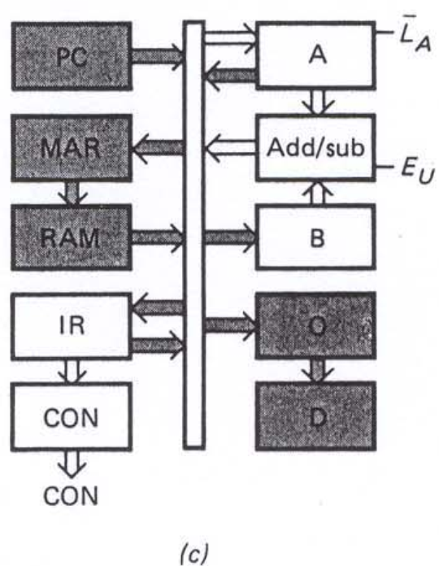
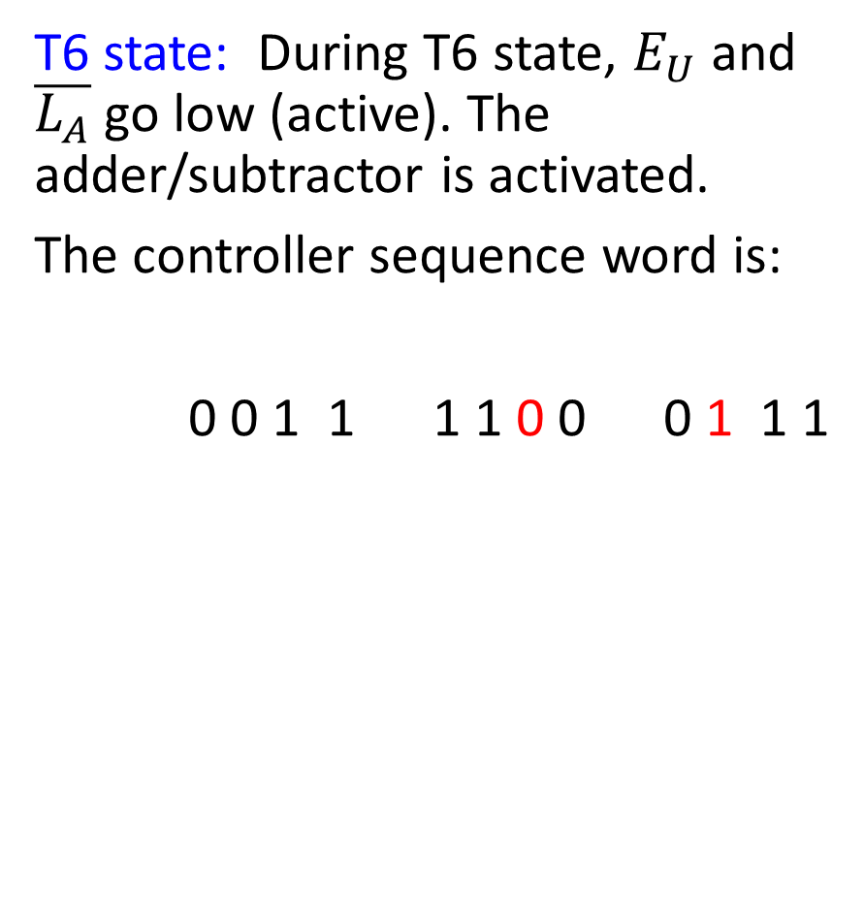
ADD routine (c) T6 state
T6 state: During T6 state, $E_{U}$ and $\overline{L_{A}}$ go low (active). The adder/subtractor is activated.
The controller sequence word is:
0 0 1 1 1 1 0 0 0 1 1 1

Slide 31
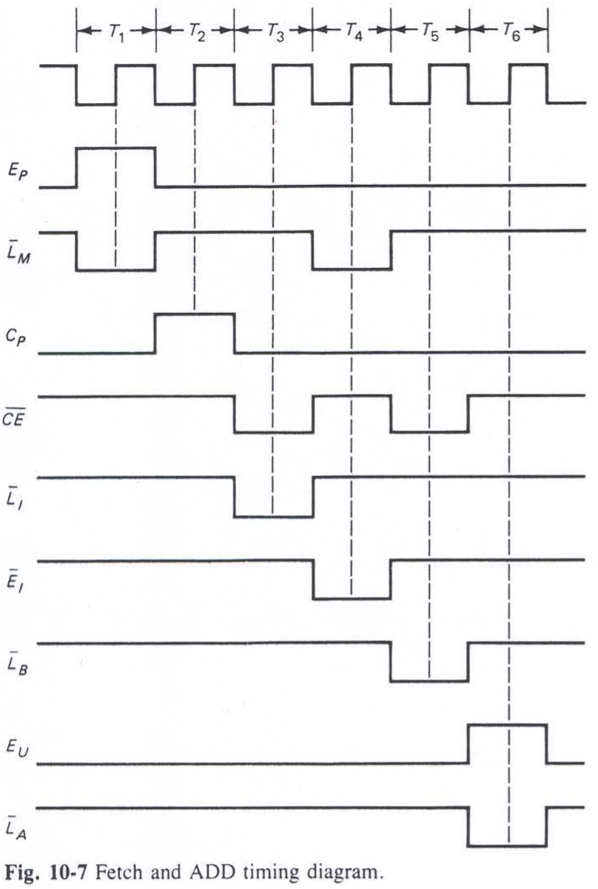
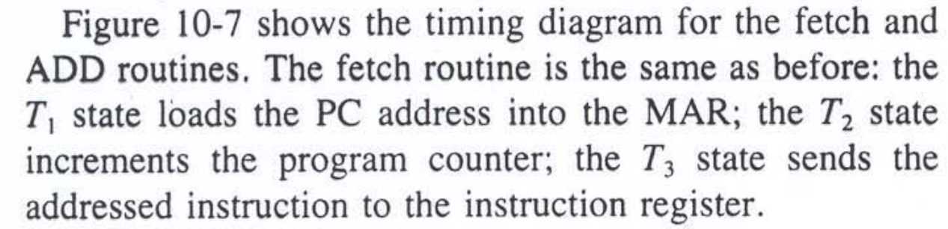
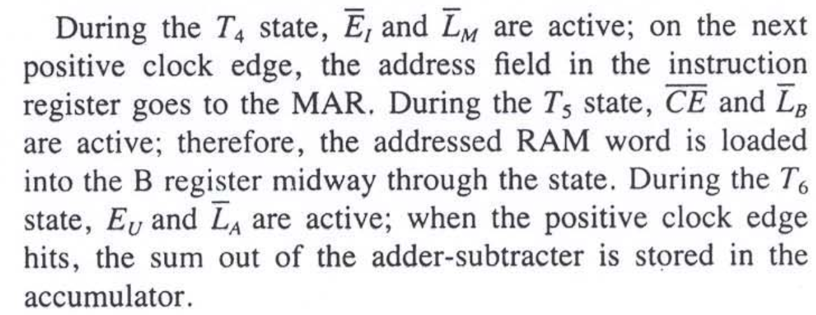
Timing diagram showing ADD routine (Fetch cycle and Execute cycle)
CLK

Slide 32
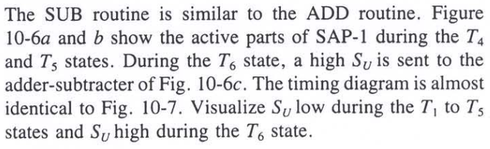
SUB routine (a) T4 state (b) T5 state (c) T6 state
S_{U}

Slide 33
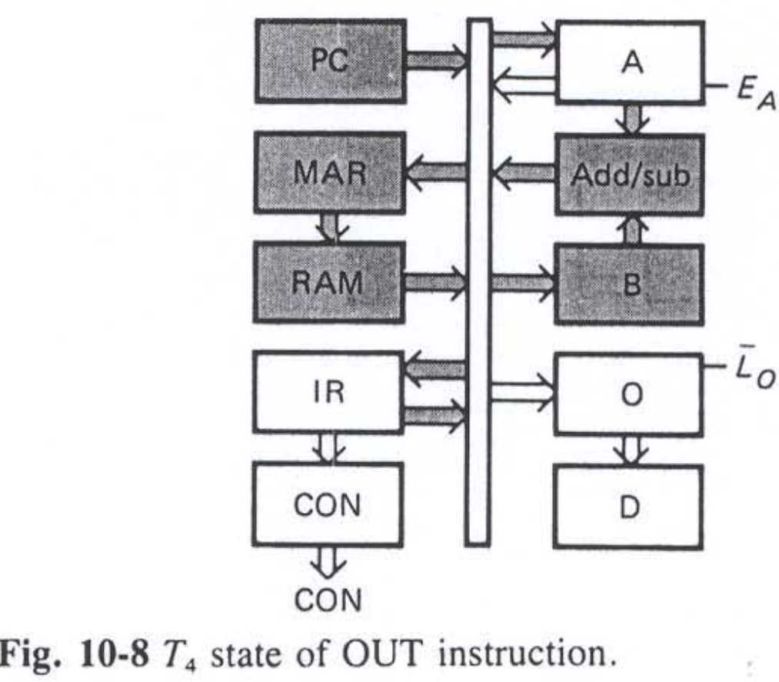
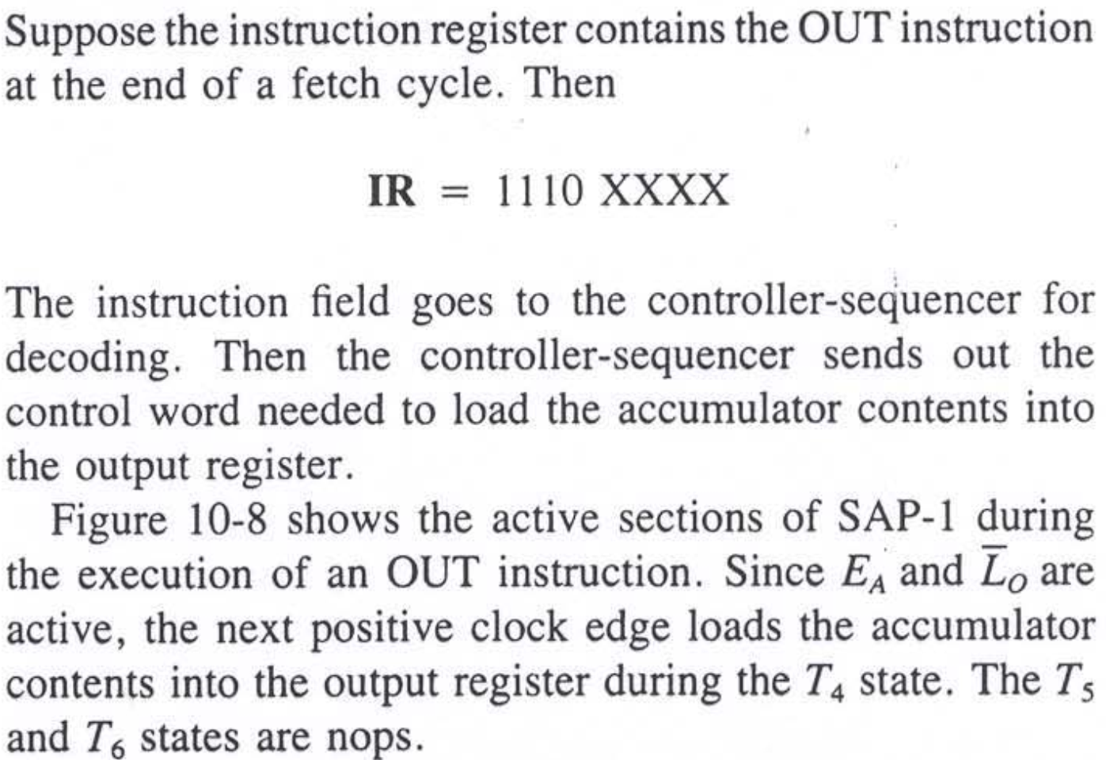
OUT routine (a) T4 state

Slide 34
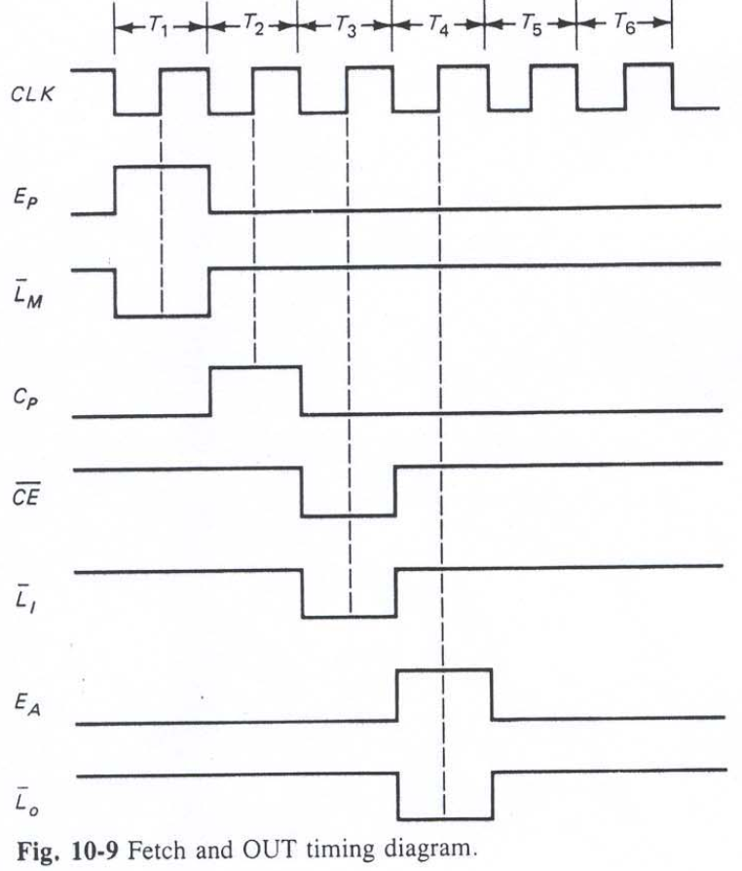
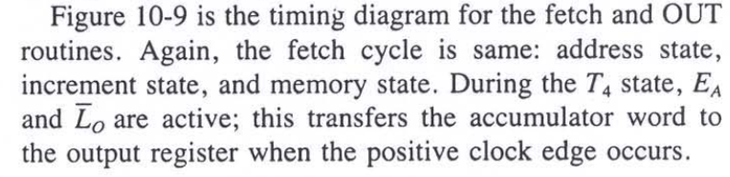
OUT routine (a) T4 state

Slide 35
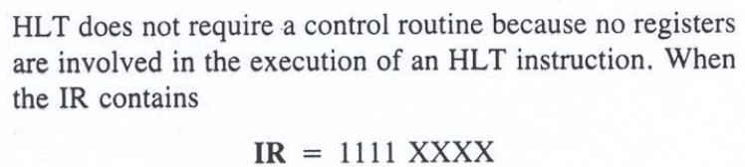
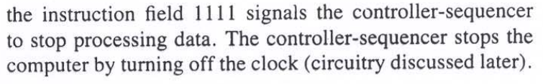
HLT routine

